Slide 1
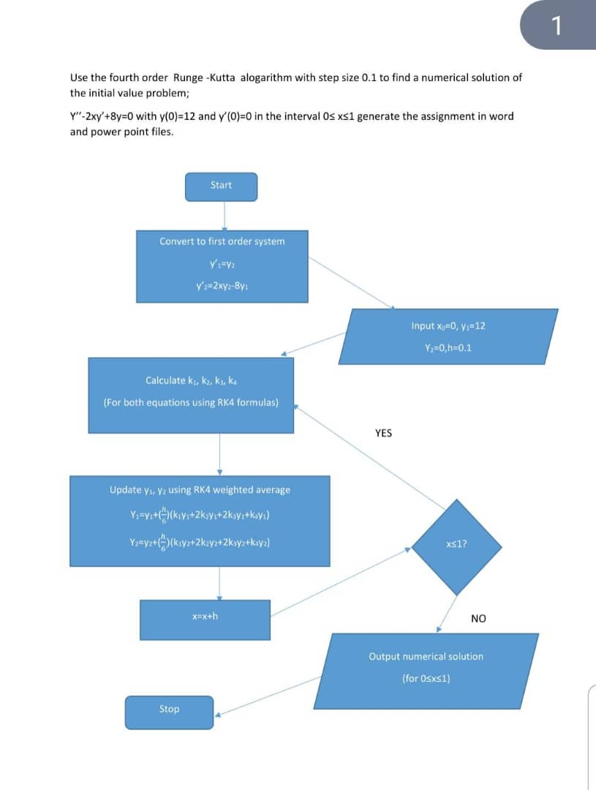
FOURTH ORDER RUNGE KUTTA METHOD

Slide 2
MATLAB CODE
%y''-2xy'+8y=0 %y(0)=12,y'(0)=0 h=0.1;
x=0;
y1=12;
y2=0;
N=10;
fprintf('x y y''\n'); fprintf('........\n');
for i=1:N+1
fprintf('%8.1f %12.6f %12.6f\n',x,y1,y2); k1_1=y2;
k1_2=2*x*y2-8*y1;
k2_1=y2+(h/2)*k1_2;
k2_2=2*(x+h/2)*(y2+h/2)*k1_2;...-8*(y1+(h/2)*k1_1);
k3_1=y2+(h/2)*k2_2;
k3_2=(x+h/2)*(y2+h/2*k2_2);...-8*(y1+(h/2)*k2_1);
k4_1=y2+h*k3_2;
k4_2=2*(x+h)*(y2+h*k3_2);...-8*(y1+h*k3_1);
y1=y1+(h/6)*(k1_1 + 2*k2_1+2*k3_1+k4_1); y2=y2 +(h/6)*(k1_2 + 2*k2_2+2*k3_2+k4_2); x=x+h;
end

Slide 3
‘FOR LOOP’
h=0.1; x=0; y1=12; y2=0; N=10;
fprintf('x y yprime\n'); fprintf('........\n'); for i=1:N+1
fprintf('%8.1f%12.6f%12.6f'\n',x,y1,y2);
k1_1=y2; k1_2=2*x*y2-8*y1;
k2_1=y2+(h/2)*k1_2; k2_2=2*(x+h/2)*(y2+h/2)*k1_2;...-8*(y1+(h/2)*k1_1);
k3_1=y2+(h/2)*k2_2;
k3_2=(x+h/2)*(y2+h/2*k2_2);...-8*(y1+(h/2)*k2_1);
k4_1=y2+h*k3_2;
k4_2=2*(x+h)*(y2+h*k3_2);...-8*(y1+h*k3_1);
y1=y1+(h/6)*(k1_1 + 2*k2_1+2*k3_1+k4_1); y2=y2 +(h/6)*(k1_2 + 2*k2_2+2*k3_2+k4_2);
x=x+h;
end

Slide 4
‘WHILE LOOP’
h=0.1; x=0; y1=12; y2=0; N=10;
fprintf('x y yprime\n'); fprintf('........\n'); while i<=N+1
fprintf('%8.1f%12.6f%12.6f'\n',x,y1,y2);
k1_1=y2; k1_2=2*x*y2-8*y1;
k2_1=y2+(h/2)*k1_2;
k2_2=2*(x+h/2)*(y2+h/2)*k1_2;...-8*(y1+(h/2)*k1_1);
k3_1=y2+(h/2)*k2_2;
k3_2=(x+h/2)*(y2+h/2*k2_2);...-8*(y1+(h/2)*k2_1);
k4_1=y2+h*k3_2;
k4_2=2*(x+h)*(y2+h*k3_2);...-8*(y1+h*k3_1);
y1=y1+(h/6)*(k1_1 + 2*k2_1+2*k3_1+k4_1); y2=y2 +(h/6)*(k1_2 + 2*k2_2+2*k3_2+k4_2); x=x+h;
end

Slide 5
PSEUDOCODE
START
Set h=0.1
Set x=0
Set y1=12
Set y2=0
WHILE X<=1
Calculate k1 for y1
Calculate k1 for y2
Calculate k2 for y1
Calculate k2 for y2
Calculate k3 for y1
Calculate k3 for y2
Calculate k4 for y1
Calculate k4 for y2
Update y1 using RK4 formula
Update y2 using RK4 formula
X=x+h
Display x,y1,y2
END WHILE
STOP

